Slide 1
Intelligent Handwritten Digit Identification System For Computer Applications Using IBM Watson Studio
Project On
(Department Of Computer Science & Engineering)
TEAM 029
Team Members:
M MAHESH(19R11A0526)
M RAVINDER(19R11A0523)

Slide 2
Introduction
Handwritten digit recognition is the ability of computers to recognize human hand-written digits.
It is a tough task for the machine because hand-written digits are not perfect.
Handwritten digits recognition is the solution to this problem that uses the image of a digit and recognizes the digit present in the image.
It is already widely used in the automatic processing of bank cheques, postal addresses and in smart phones, etc.

Slide 3
Problem Statement:
The goal of this project is to create a model that will be able to recognize and determine the handwritten digits from its image by using the concepts of Convolution Neural Network. Though the goal is to create a model which can recognize the digits, it can be extended to letters, and an individual handwriting. The major goal of the proposed system is understanding Convolutional Neural Network, and applying in the handwritten recognition system.

Slide 4
Problem Solution:
We will develop a machine learning model which can take handwritten digit as input.
The model will be trained with dataset containing hand written digits..
The model will be tested and compiled.
We create a User-Interface thru which, we can give our model the input and let it predict the number.

Slide 5
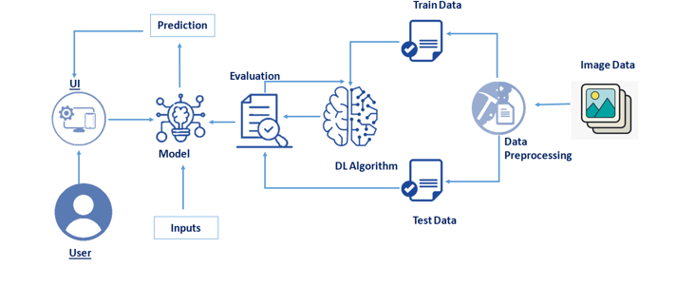
Technical Architecture:

Slide 6
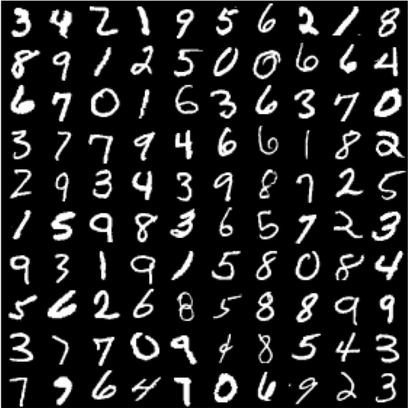
Training Dataset
Training of the network is done by a dataset named MNIST dataset.
MNIST dataset has a training set of 60,000 examples, and a test set of 10,000 examples.
All the images in the dataset atre of 28*28 pixels.
It is a good database for people who want to try learning techniques and pattern recognition methods on real-world data while spending minimal efforts on preprocessing and formatting

Slide 7
Why Convolution Neural Networks?
Convolution is a simple mathematical operation between two matrices in which one is multiplied to the other element wise and sum of all these multiplications is calculated.
Convolutions are performed for various reasons:
Convolutions provide better feature extraction
They save a lot of computation compared to ANNs.
Less number of parameters are created than those in pure fully connected layers.
Due to less number of required parameters, lesser fully connected layers are needed.

Slide 8
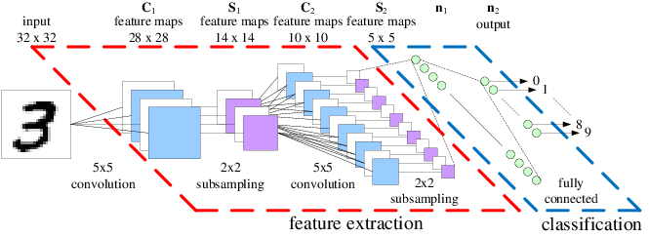
Architecture of Convolution Neural Networks:

Slide 9
Project Flow:
Project Flow:
The user interacts with the UI (User Interface) to upload the image as input
The uploaded image is analyzed by the model which is integrated
Once the model analyses the uploaded image, the prediction is showcased on the UI
To accomplish this, we need to complete all the tasks listed below:
Understanding the data.
  Importing the required libraries
  Loading the data
  Analyzing the data
  Reshaping the data.
  Applying One Hot Encoding
Model Building
  Creating the model and adding the input, hidden and output layers to it
  Compiling the model
  Training the model
  Predicting the result
  Testing the model by taking image inputs
  Saving the model
Application Building
  Create an HTML file
  Build Python Code

Slide 10
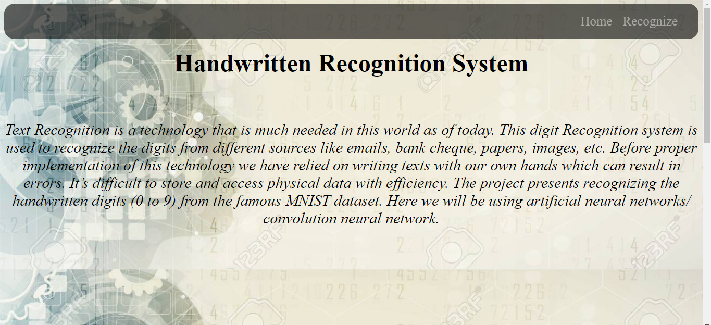

User Interface:

Slide 11
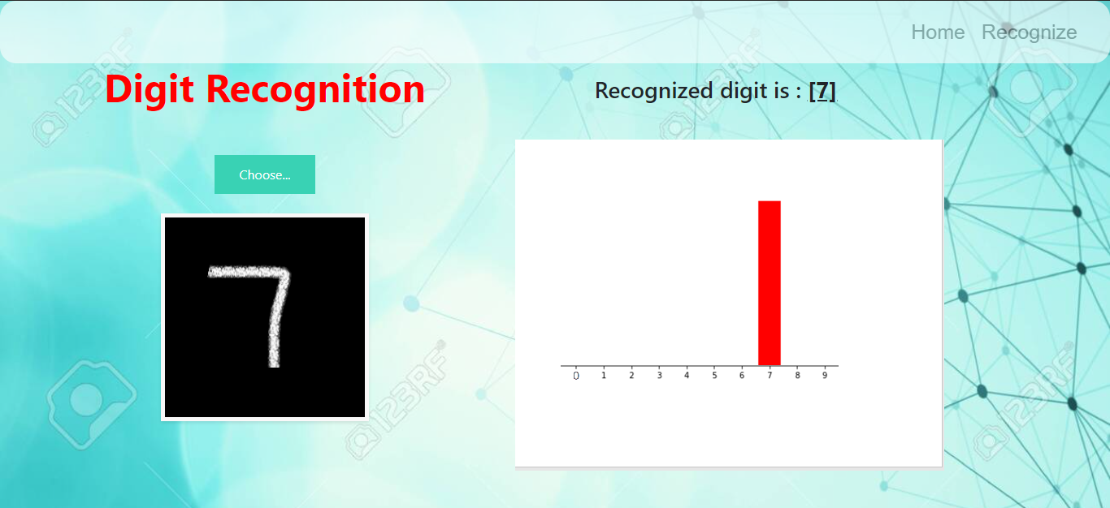
Prediction / Output:

Slide 12
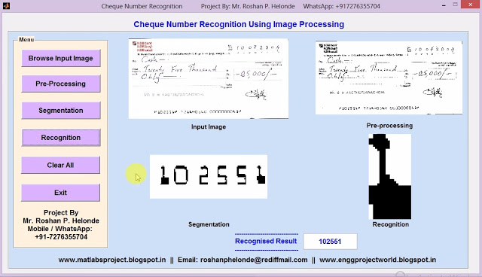
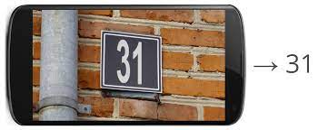
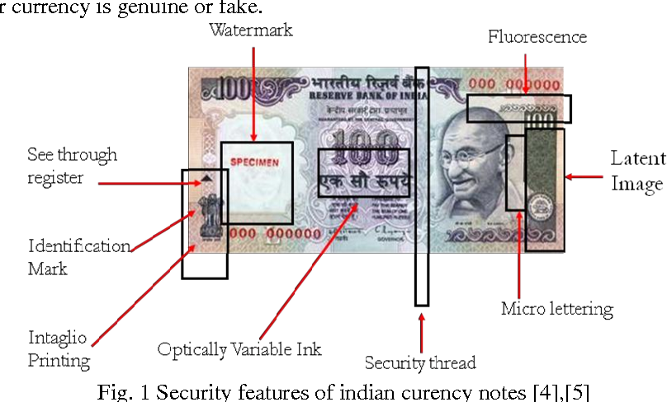
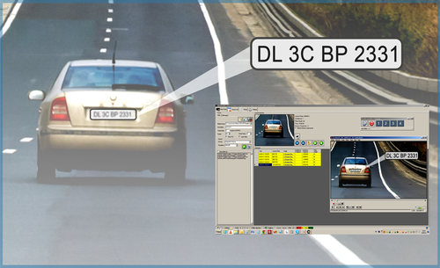
Applications :
Cheque Book Number Recognition
House Number Recognition
Currency recognition
Number Plate recognition

Slide 13
Conclusion :
We can predict the hand-written digit through this application. Our project is limited to predict only one digit at a time. We can create more applications which can predict a set of digits, set of characters, set of digits and numbers combined, and so on. This technology is widely used in Automation Industry and Cyber Security cell. We can get a wide range of knowledge about Neural Networks and data processing. This project can help one-self how to deal with various aspects of Machine Learning and Deep learning.

Slide 14
Thank You

